Slide 1
Machine Learning Group Project
Team 3: Flight tickets price predictions
Member: Annie Ho, Cooper Li, Jivant Khatri, Steve Leung
Notes:
as large sub-categories 156 features PCA?

Slide 2
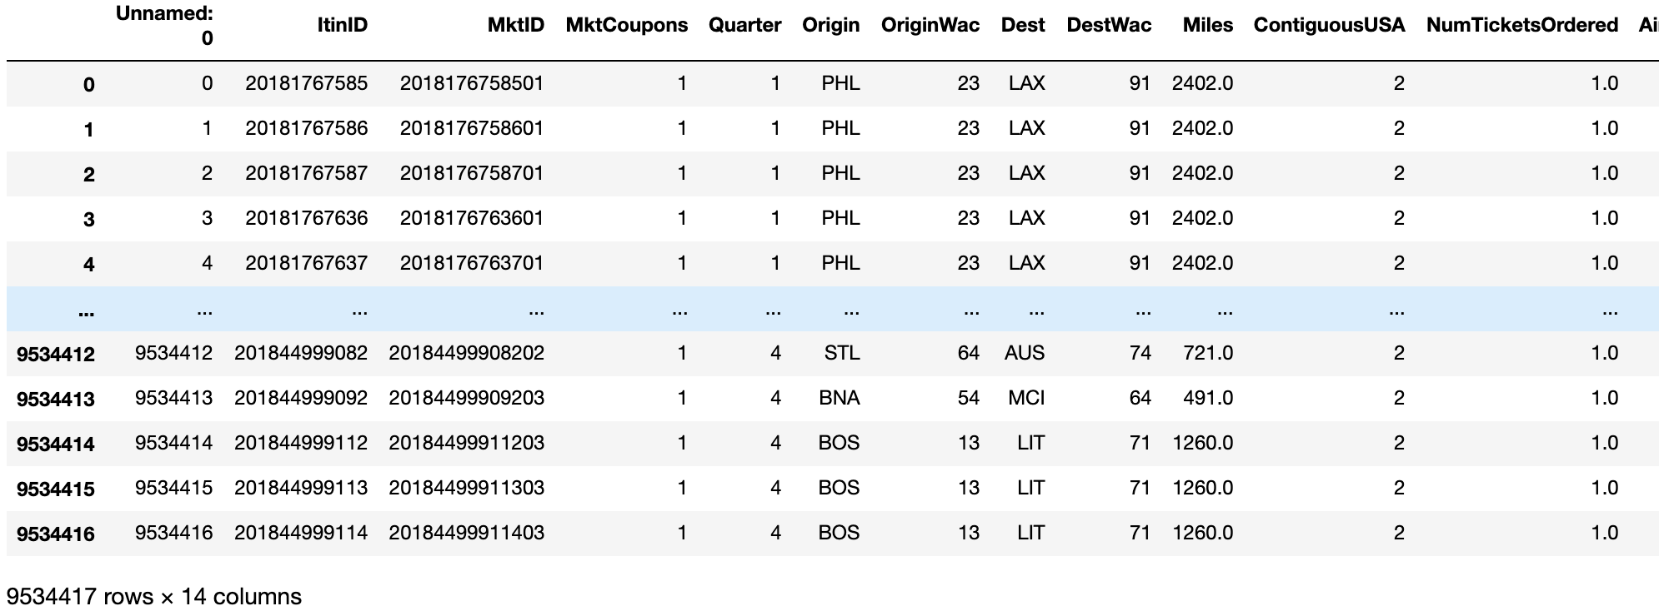
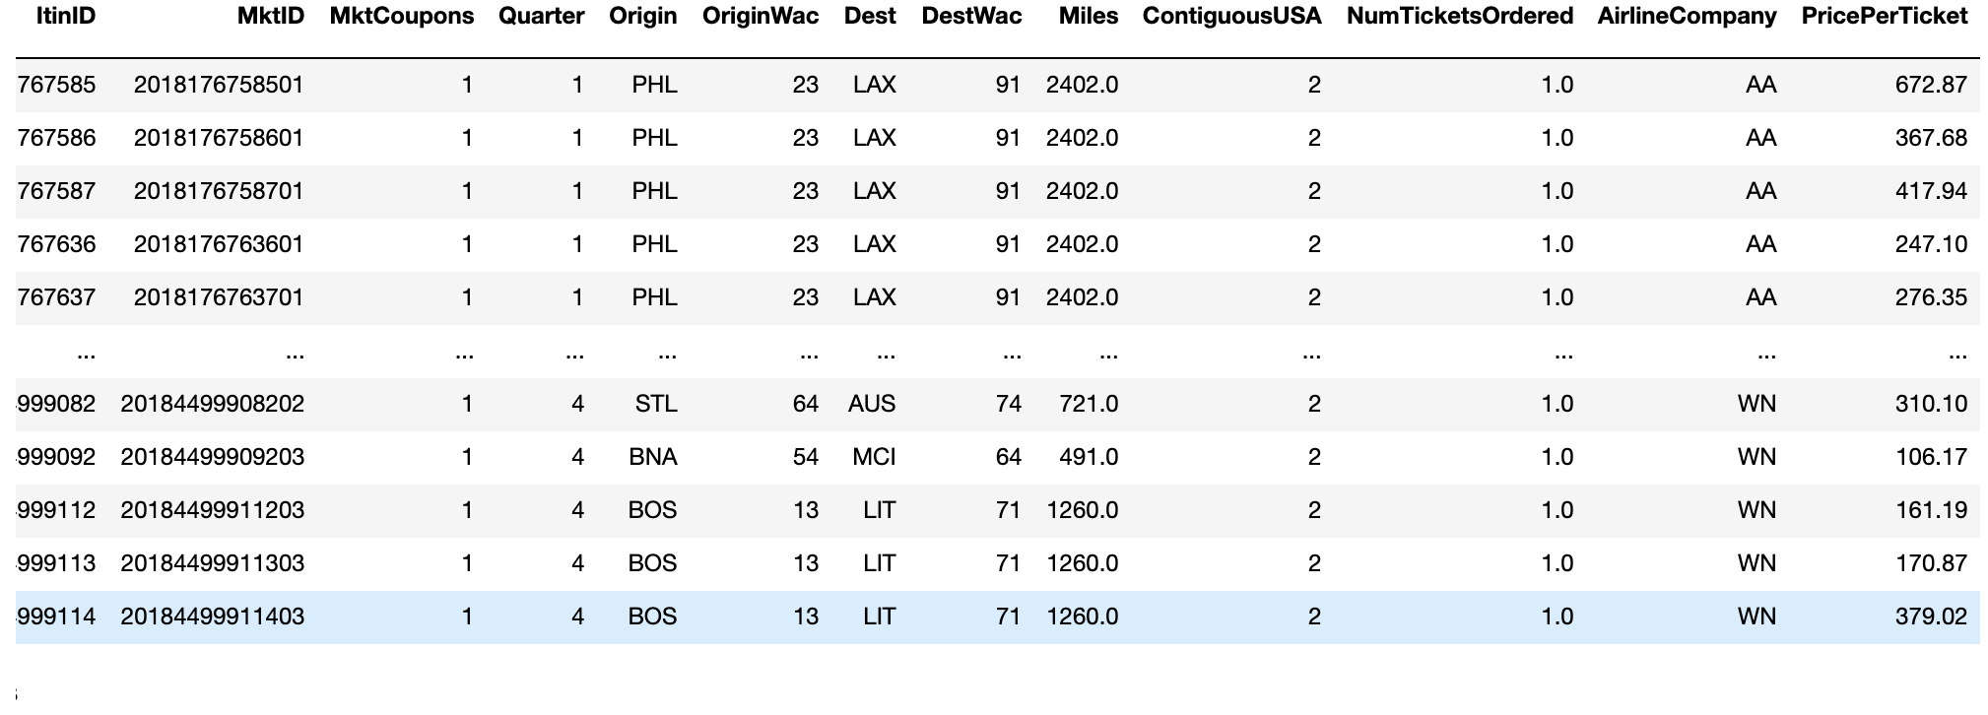
Data Collection
Kaggle: https://www.kaggle.com/zernach/2018-airplane-flights
The Bureau of Transportation Statistics: https://www.bts.gov/

Slide 3
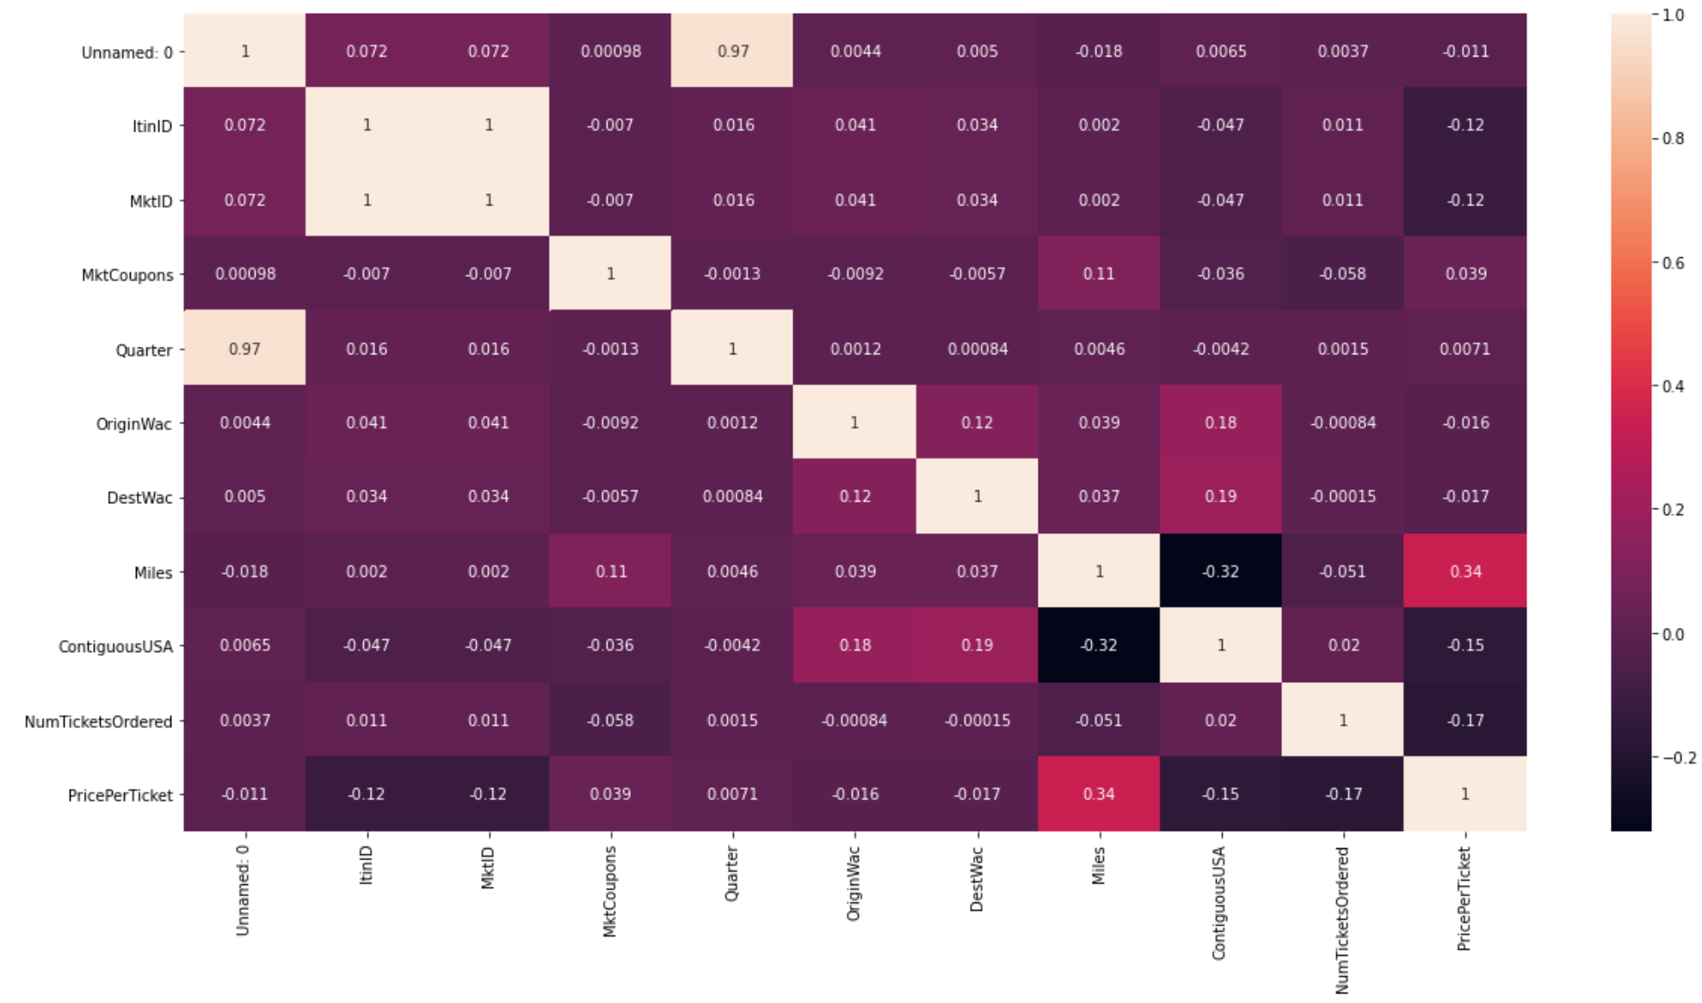
Data Exploration
Check for correlations of different columns

Slide 4
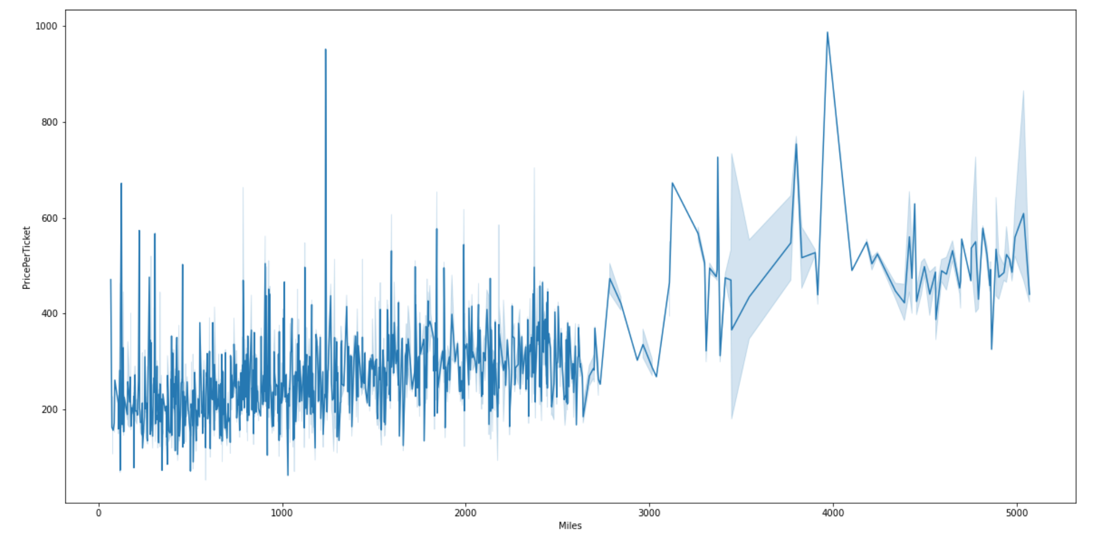
“Price per ticket” vs “Miles”

Slide 5
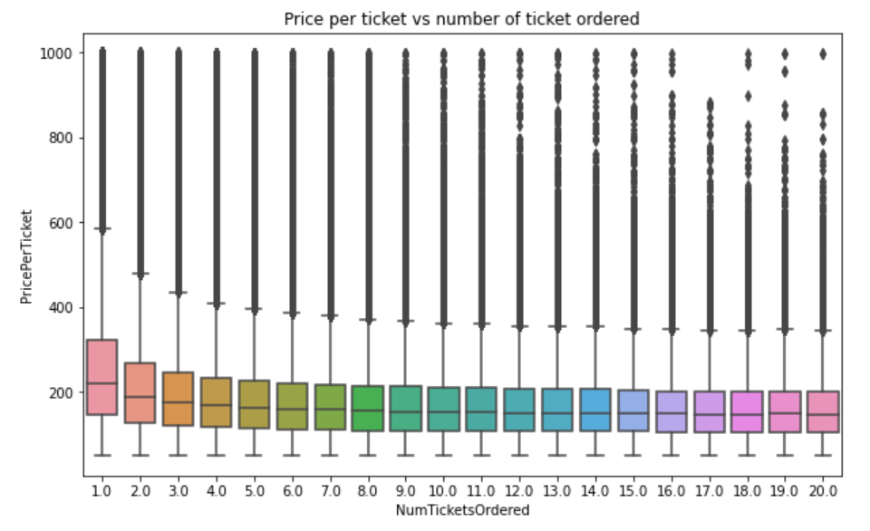
The more the tickets ordered the lower the price per ticket.

Slide 6
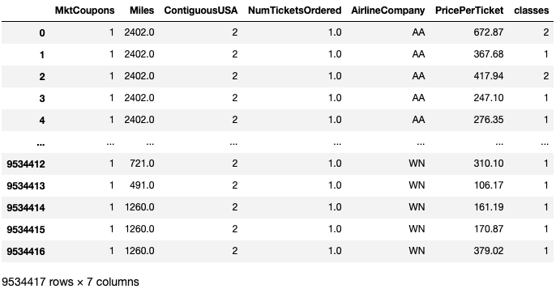
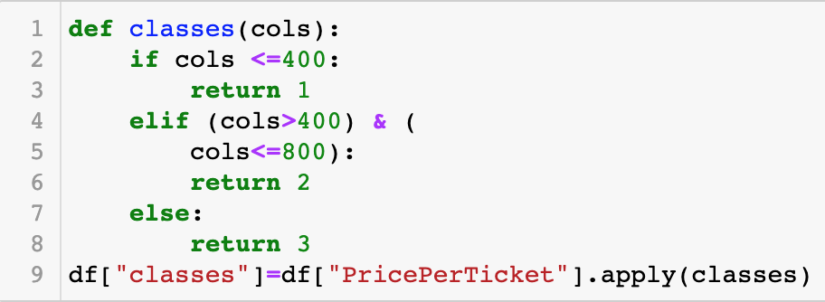
Preprocessing

Slide 7
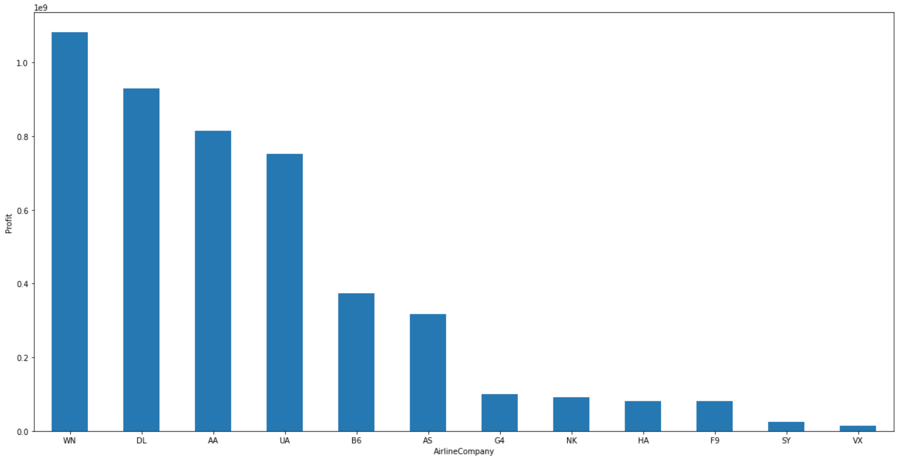
Competitors
Main competitors:
WN -- Southwest Airlines Co. DL -- Delta Air Lines Inc.
AA -- American Airlines Inc. UA -- United Air Lines Inc.

Slide 8
Application of Machine learning
Linear Regression (LR)
XGboost
Random Forest
Decision Tree

Slide 9

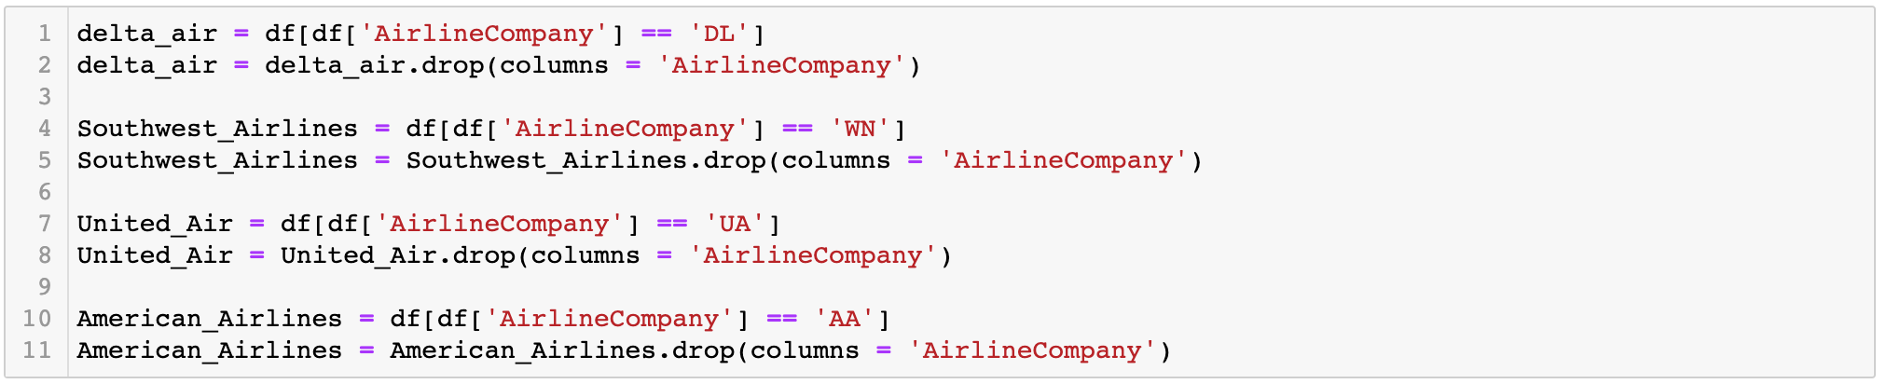
Linear Regression Model Creation

Slide 10
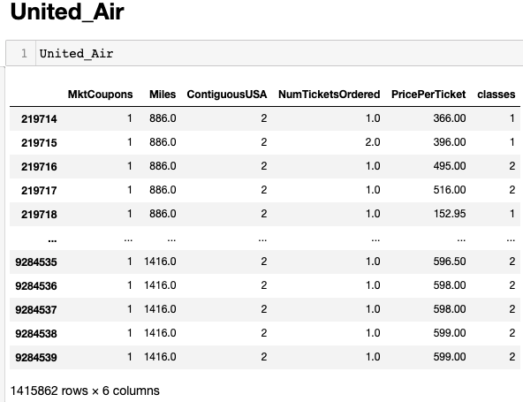
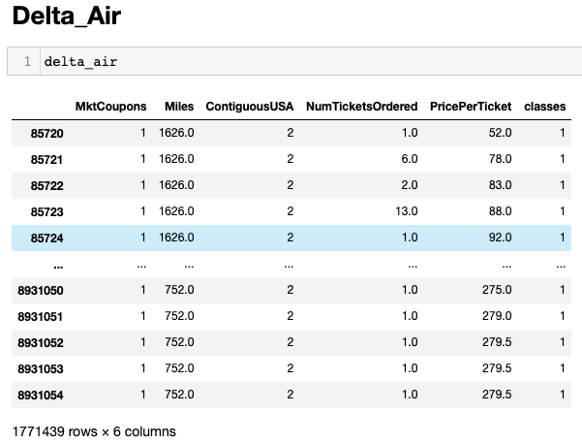
Linear Regression Model Creation

Slide 11
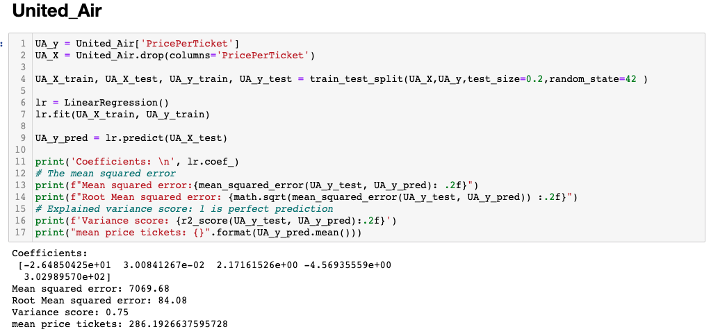
Linear Regression Model Creation

Slide 12
Airlines comparison
Airlines | Variance Score | Variance Score(after gridsearch) | Average price
WN -- Southwest Airlines Co. | 0.43 | 0.43 | 194.83
DL -- Delta Air Lines Inc. | 0.67 | 0.67 | 268.80
AA -- American Airlines Inc. | 0.72 | 0.72 | 273.52
UA -- United Air Lines Inc. | 0.75 | 0.75 | 286.19
Notes:
# Issues: # Low variance score, low accuracy.# High bias

Slide 13
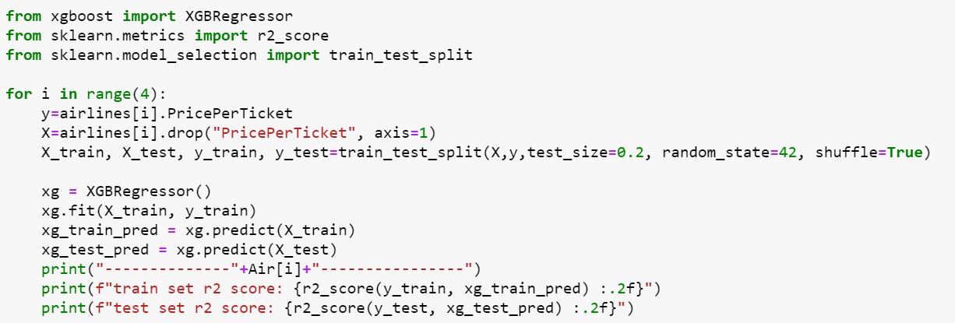
XGBoost

Slide 14
XGBoost
Airlines | Variance Score | Average price
WN -- Southwest Airlines Co. | 0.46 | 194.83
DL -- Delta Air Lines Inc. | 0.70 | 268.79
AA -- American Airlines Inc. | 0.75 | 273.47
UA -- United Air Lines Inc. | 0.77 | 286.29

Slide 15
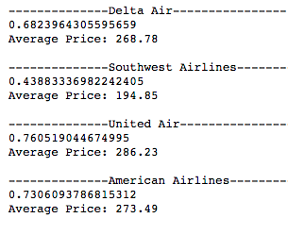
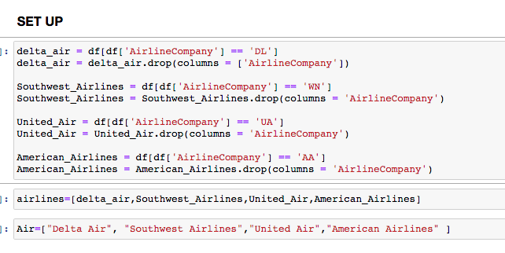
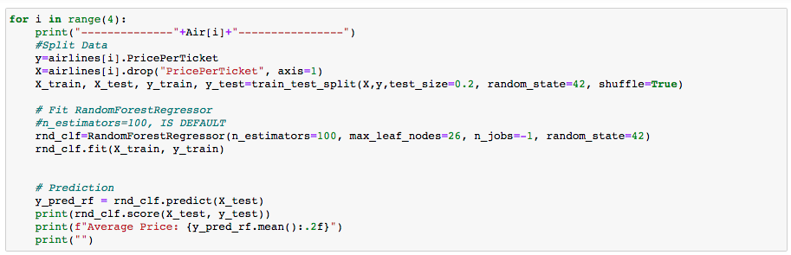
Random Forest

Slide 16
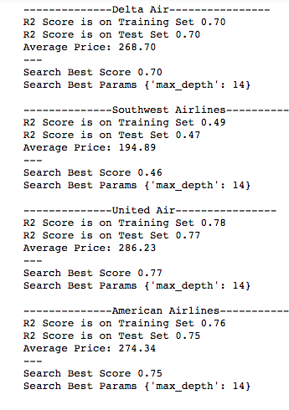
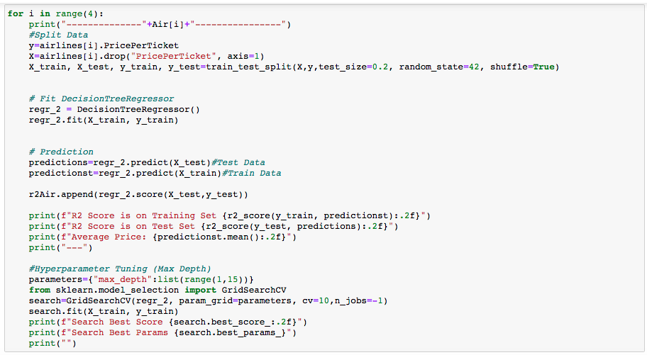
Decision Tree

Slide 17
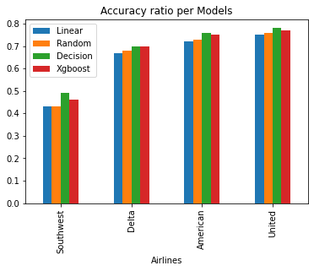
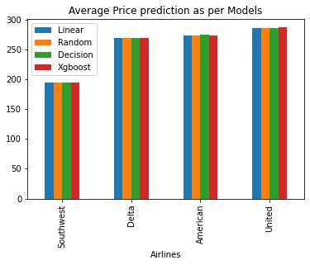
Model Evaluation and Comparison
Variance Evaluation On testing Set
Average Price On testing Set
Airlines | Linear Reg | Random Forest | Decision Tree | XgBoost
Southwest Airlines Co. | 0.43 | 0.43 | 0.49 | 0.46
Delta Air Lines Inc. | 0.67 | 0.68 | 0.70 | 0.70
American Airlines Inc. | 0.72 | 0.73 | 0.76 | 0.75
United Air Lines Inc. | 0.75 | 0.76 | 0.78 | 0.77
Airlines | Linear Reg | Random Forest | Decision Tree | XgBoost
Southwest Airlines Co. | 194.83 | 194.85 | 194.89 | 194.83
Delta Air Lines Inc. | 268.80 | 268.78 | 268.70 | 268.79
American Airlines Inc. | 273.52 | 273.49 | 274.34 | 273.47
United Air Lines Inc. | 286.19 | 286.23 | 286.23 | 286.29
Notes:
# Issues: # Low variance score, low accuracy.# High bias

Slide 18
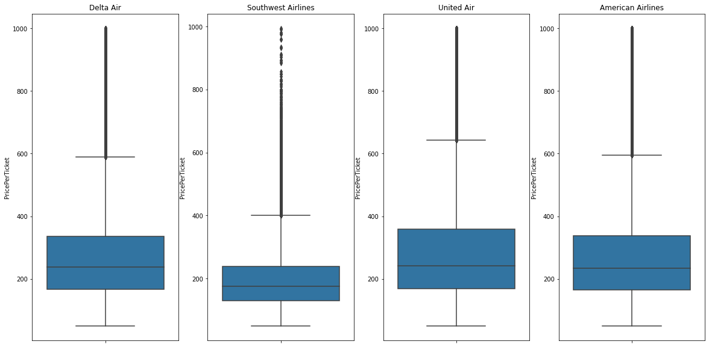
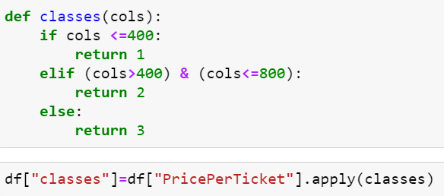
-Southwest Airlines has a relatively low ticket price
-The ‘class’ feature doesn’t apply well on Southwest Airlines

Slide 19
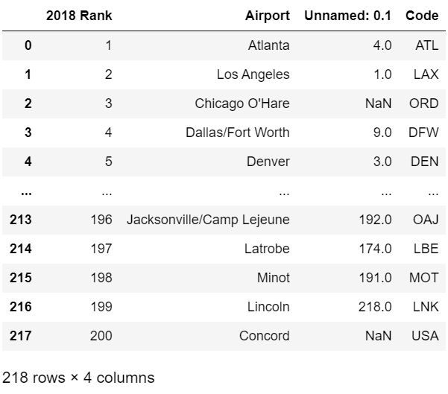
Further improvements
Airport rankings
Notes:
we have try ways to improve features in dataset
Airport rankings according to quality and customers feedback
-> very low correlation
->wrong ranking, if according to originating domestic passengers against the annual ticket price
-> airports rank the top and the bottom has significant high price
impossible to get class of ticket
we try to classify by the price by ticket
the R2 score improve a lot but its kind of robust, why?
we can improve by justisfying the class by other data,

Slide 20
Future Improvements
Include more factors into datasets
Parameters affecting the ticket price:
Volume of tickets available and sold
Base fare, Taxes and airport fees, Fuel surcharge
Service fee to issue, Baggage
Class, Date and time, Food Seat selection
Source: https://flightfox.com/tradecraft/how-do-airlines-set-prices
https://towardsdatascience.com/deep-learning-in-finance-is-this-the-future-of-the-financial-industry-a29b561031e9
Notes:
In additional to class and airport ranking, customer feedbacks -> number of originating traveler
other important features are listed there.
volume with details like class, when, origin and destination -> highly related to price in economic sense, difficult to extract
Service fee to issue, Food Seat selection
implies quality of the service, deterministic as well
Adapt algorithms suitable for time series forecasting
Recurrent Neural Network (RNN)
Good performance over short and long time horizon
Robust to outliers and noisy data
support Non-linear modeling and Multi-step forecasting
For the suggestion of new algorithm try:
RNN -> strength .. .. ..
in short, -> good at modelling financial data

Slide 21
Conclusion
The model gives a reasonable price predictions.
Our company:
Gains insights on the general trend of the industry
Stick to the market price to reduce volatility
Adapts pricing strategies accordingly and stay competitive
Set a proper markdown price against industry counterparts
The R-squared scores among companies are relatively low (0.4~0.7).
Causes:
Data does not sufficiently explain the variance of the target variable
hindering the algorithms to learn the correct pricing rules
The algorithms failed to learn the pricing rules
Increasing deviation from true values and the likelihood of wrong predictions
Notes:
In conclusion, the above models can give us an reasonable price predictions on our competitors. And this price prediction can be transform into very valuable knowledge as the flight tickets are major source of income of a airline company. First, it gives our decision maker more insight over the general trend of the aerial industry, and therefore,can make a more comprehensive decision with aid of information. Second, specifically,
we can adapt pricing strategies based on the price prediction, such as a markdown on the ticket price. maximized overall profit
//
A proper markdown price can boost our sales. Although the profit per ticket is lower, the overall profit can be maximized owing to the sales.
In short, with the price prediction our company can stay aware of the change in industry while maintaining company’s competitiveness.
//
Besides of utilizing the predictive model,//
//
Also we found the predictive model has room for improvement. As shown in the previous slides, the R-squared scores among companies are relatively low, around 0.4-0.7, which implies the predictions from models are not very accurate.
There are two major causes. First, the data doesn’t sufficiently explain the variance of the ticket price. Like the class of the ticket is not given, but it is a extremely important indicator of ticket price in all sense.
//
Once we don’t have this features and no other related features are input, we lose our precision very badly. In turn, the data hinder the learning process of algorithms.
//
Second, the machine learning algorithms we used maybe ineffective when making this kind of predictions. We can always switch to another algo when we don’t have a satisfactory estimate.
//
Move over, I would like to stress on effect of ineffective models. The wrong models tend to increase the deviation from true values and the likelihood of wrong predictions.
//
But I think this is not the major problem related to the dataset. We should put most of the effort into refining the dataset.

Slide 22
Thank you everyone.

